Slide 1
Art of Slither
Robo-Physics Bootcamp 2025
Presenters:
Malik Nauman Rauf
Rabin Baral

Slide 2
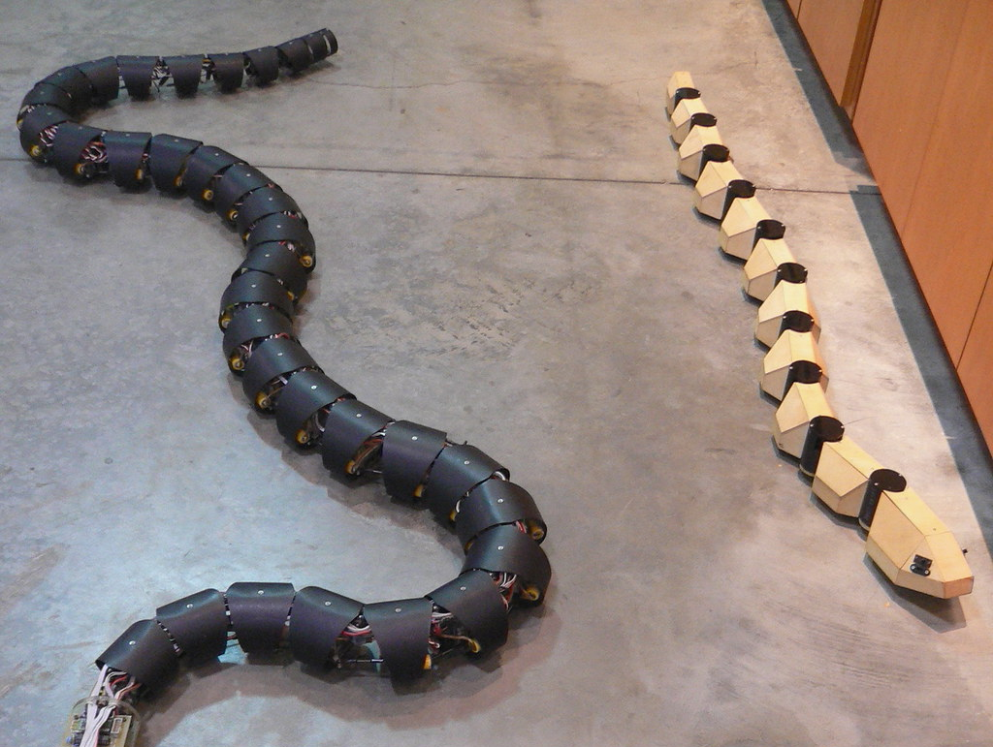
Contents
Bootcamp Experience
Project Description
Accomplishments

Slide 3
Bootcamp Experience

Slide 4
Bootcamp Experience
Explored the core principles of physics-informed robotics.
Constructed our first functional 3-link swimmer, understanding fundamental mechanics.
Key Takeaway: Arduino Programming, How physics dictates robotic design and initial locomotion.
Day 2: Modeling the Motion
Learned advanced modeling techniques for multi-link swimmers.
Explored the computational framework for simulating complex robotic movements.
Key Takeaway: Translating physical systems into robust digital models for analysis and prediction.
Day 3: Innovate & Implement
Pitched and refined our unique robophysics project ideas.
Began active work on individual and group projects, applying learned principles.
Key Takeaway: Comprehension of the underlying principles through Hands-on work.
Day 1: Foundations & First Forms

Slide 5
Project

Slide 6
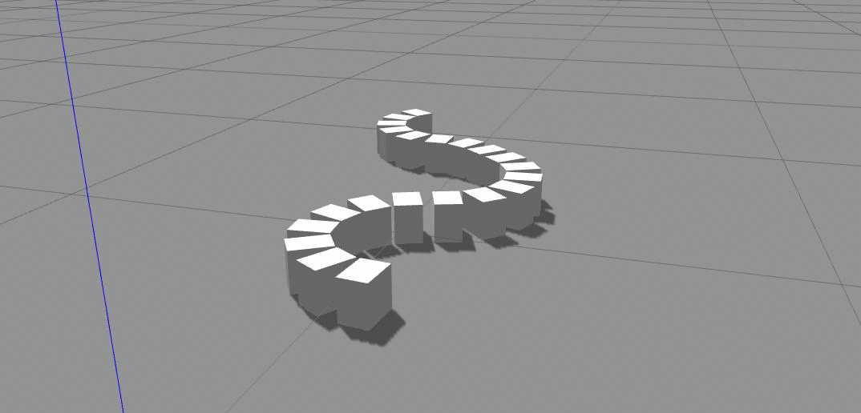
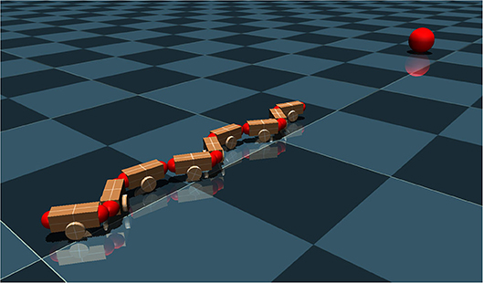
Motivation

Slide 7
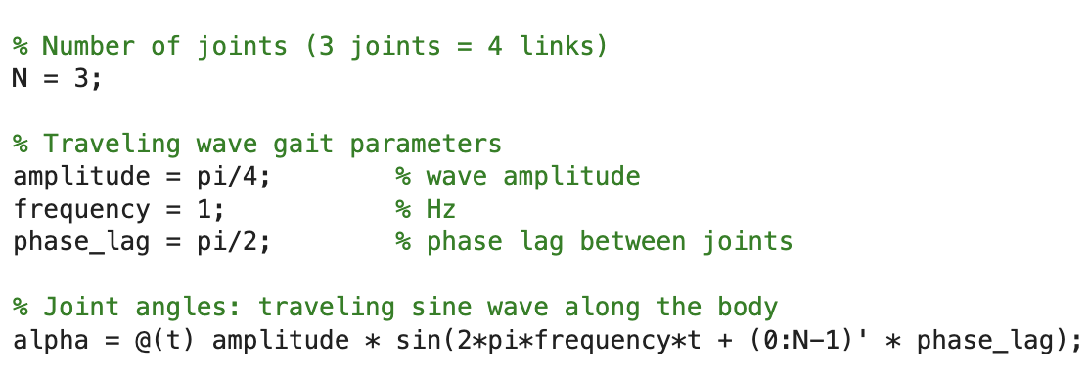
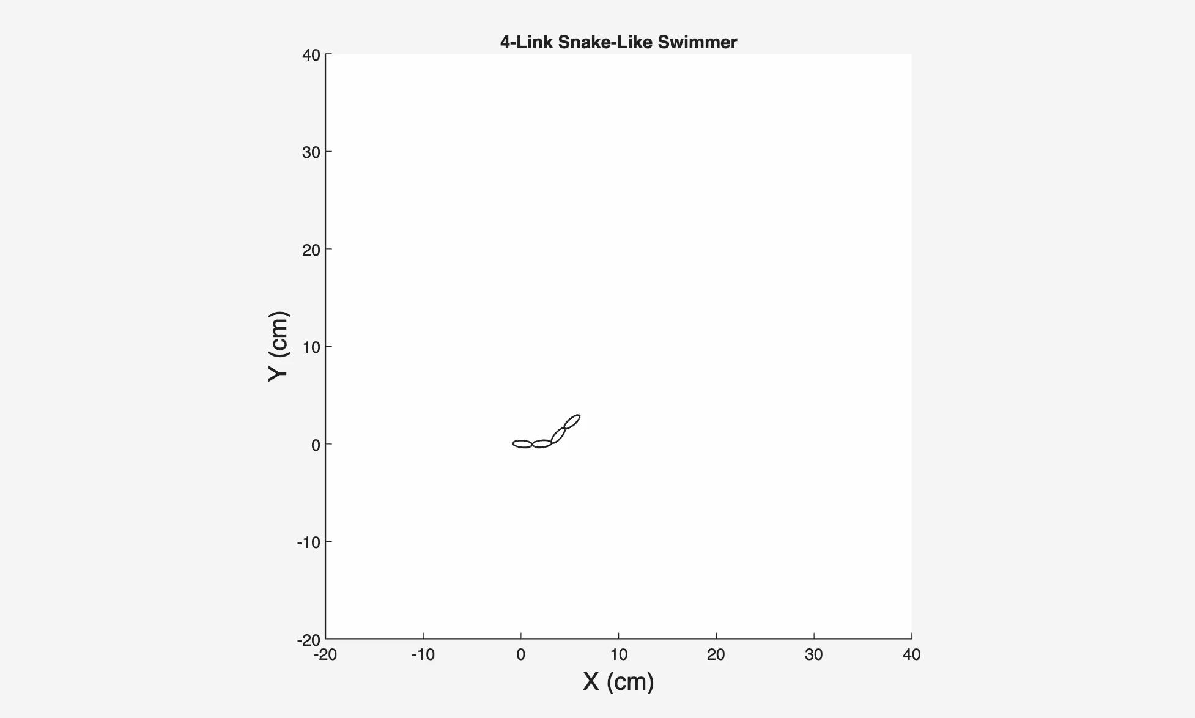
Simulation

Slide 8
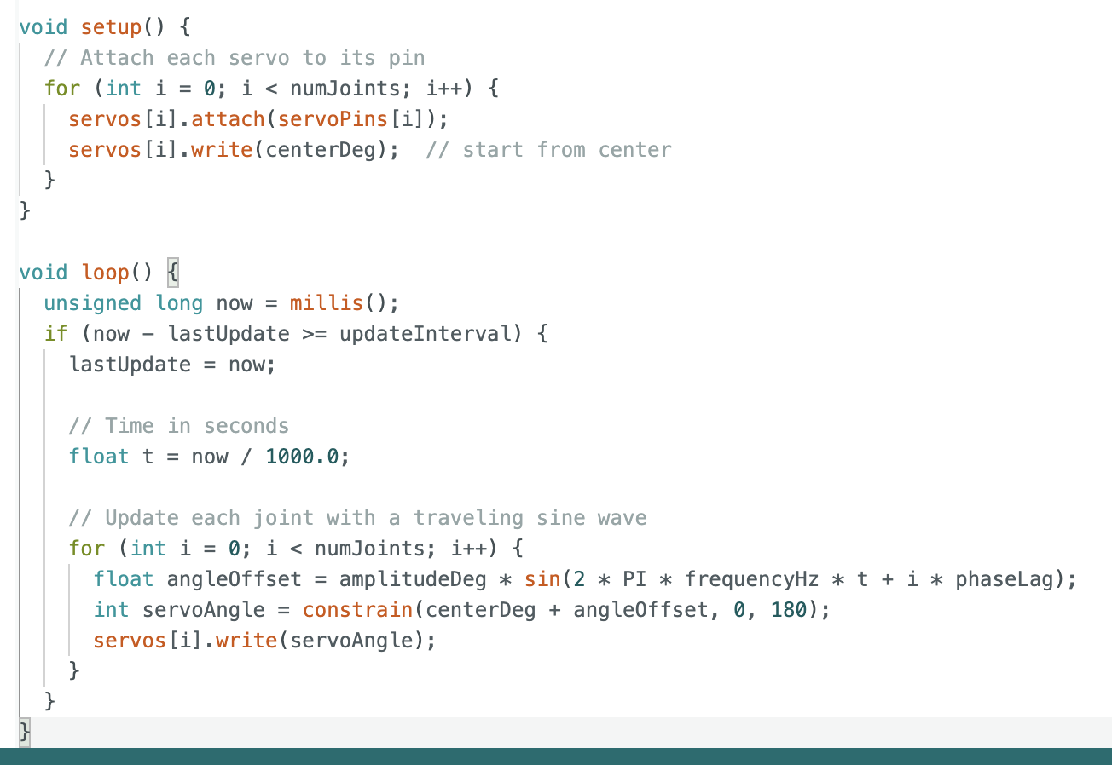
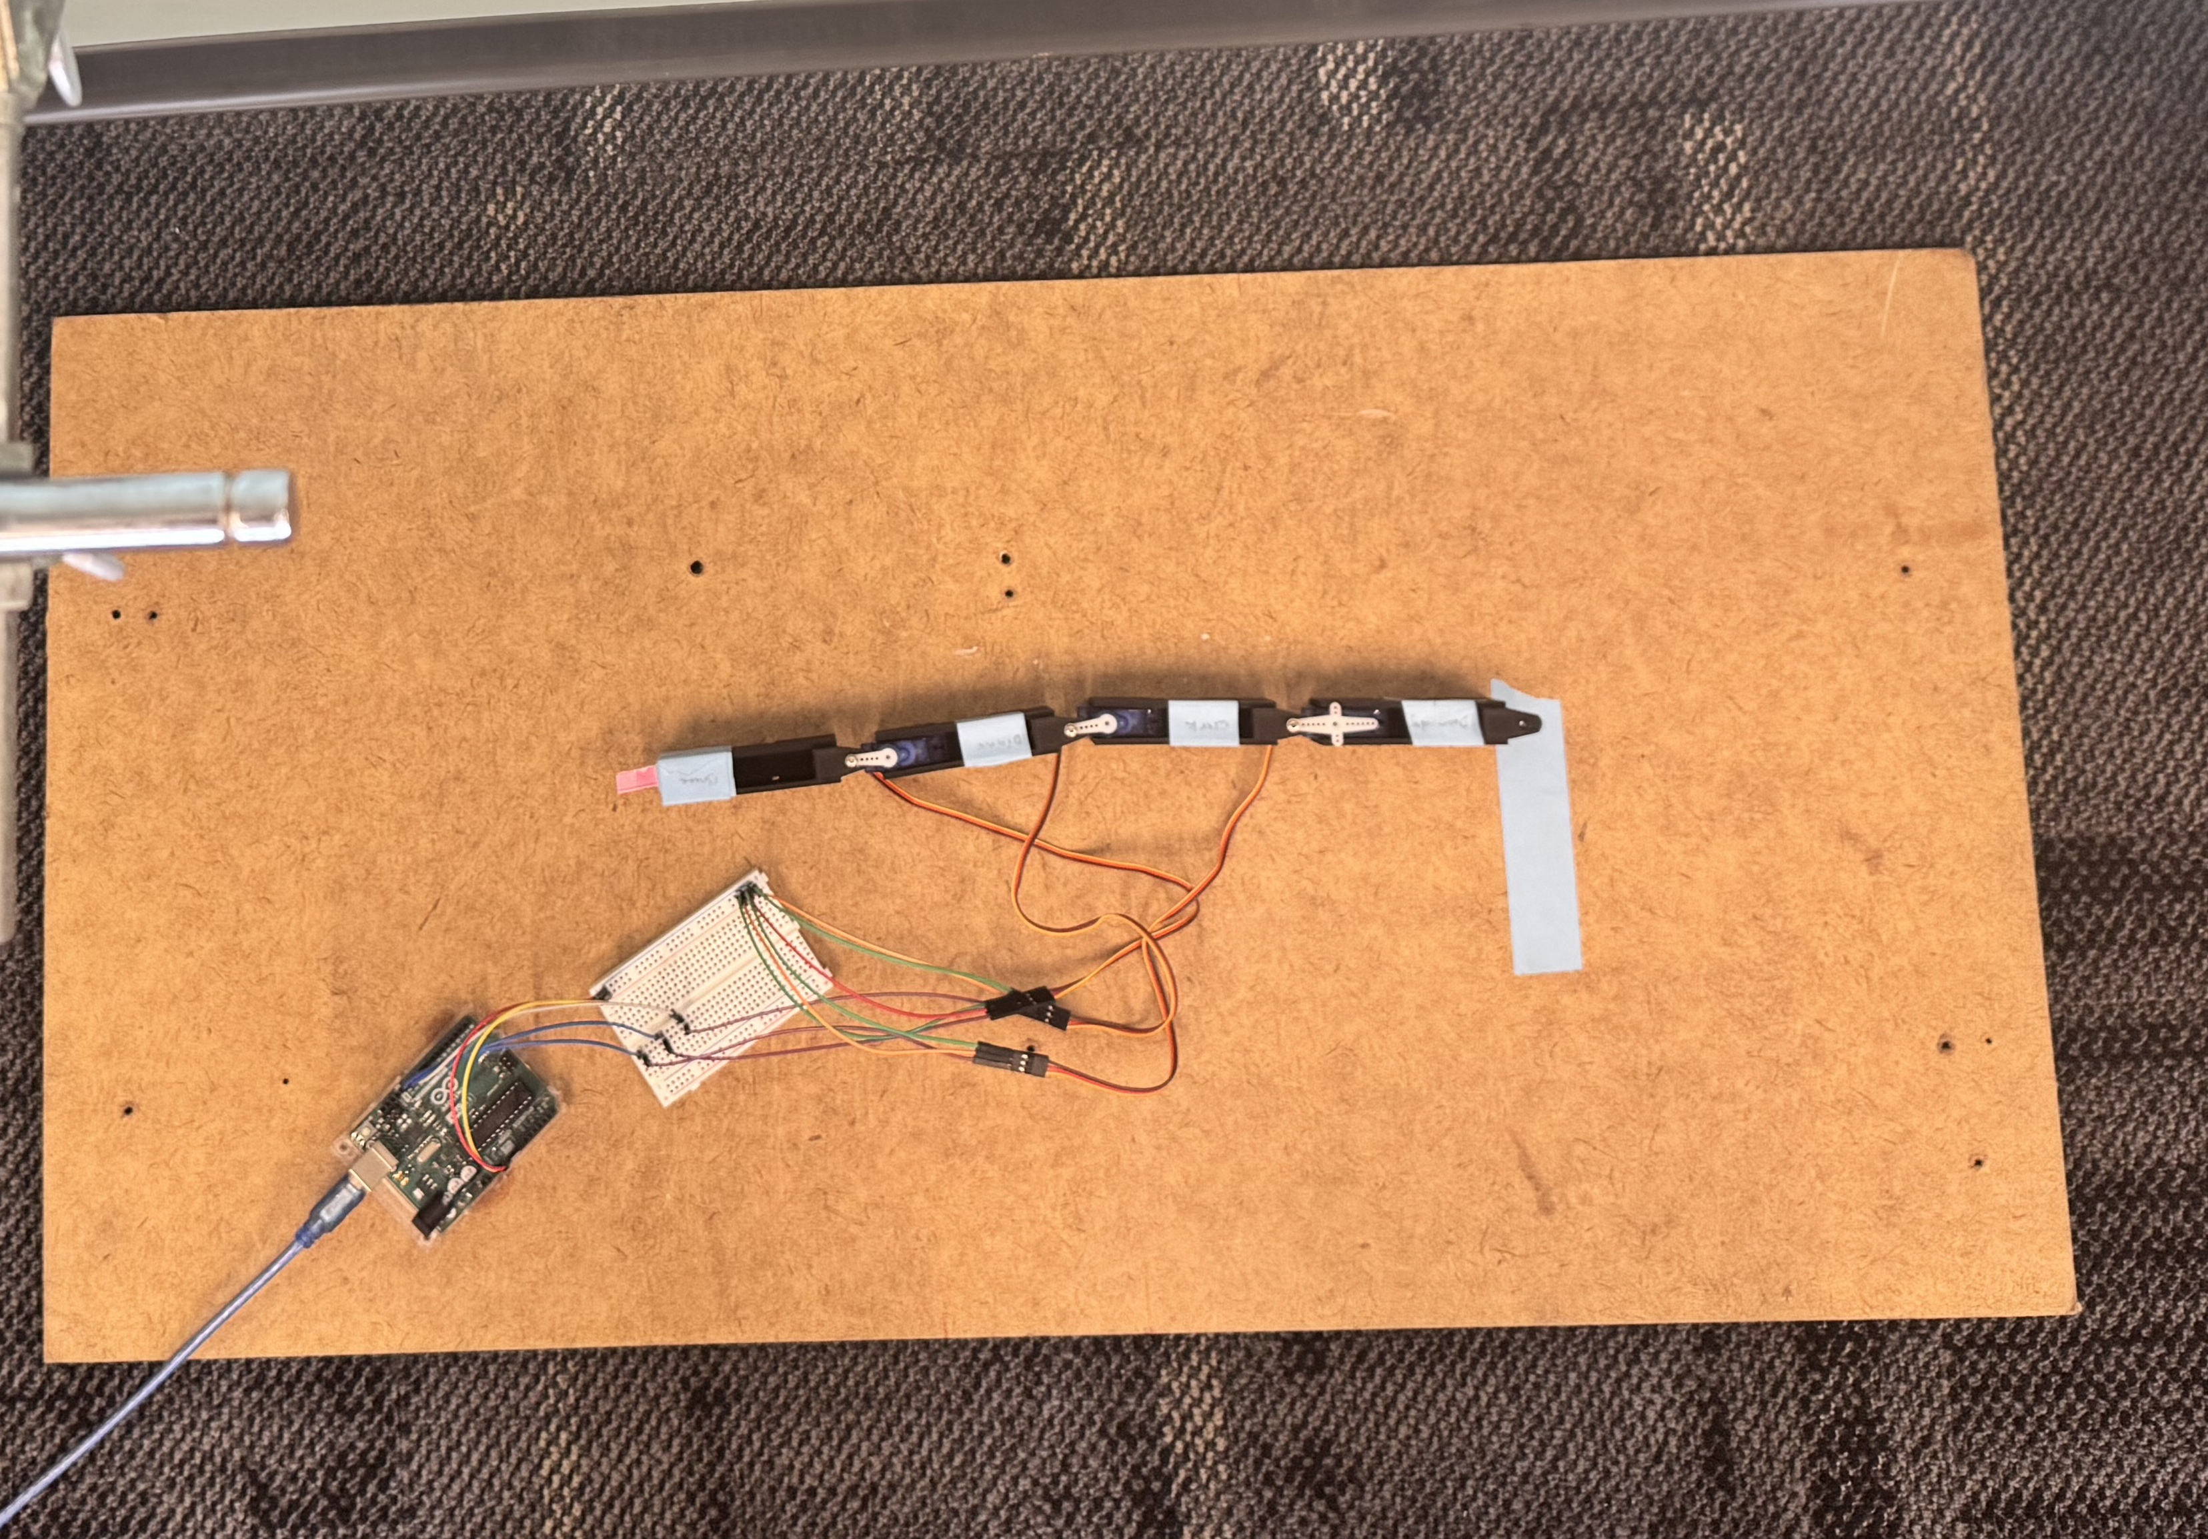
Implementation
Diana
Doomsday
Bruce
Clark
Starting Point

Slide 9
Results

Slide 10
Results
For demonstration, we chose to experiment with changing robot base;
  Big Tyres
  Small Tres
  Legs
  Bare
We track the position of Bruce

Slide 11
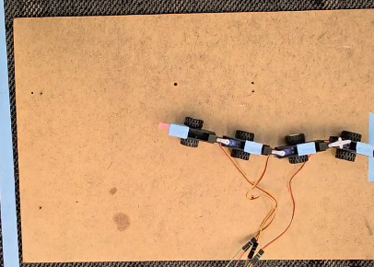
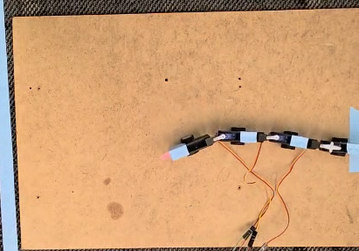
Results
Big Tyres
Small Tyres
Notes:
An increase in friction results in smaller amplitude. Another thing is that we couldn’t really take into account the actual frictional model

Slide 12
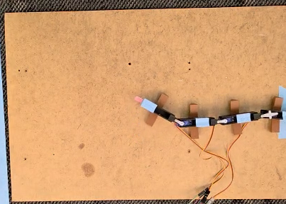
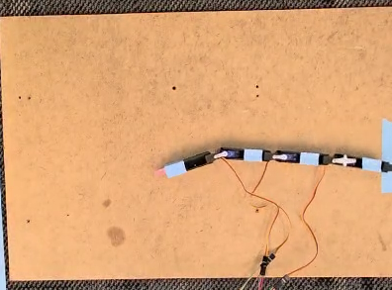
Results
Legs
Bare

Slide 13
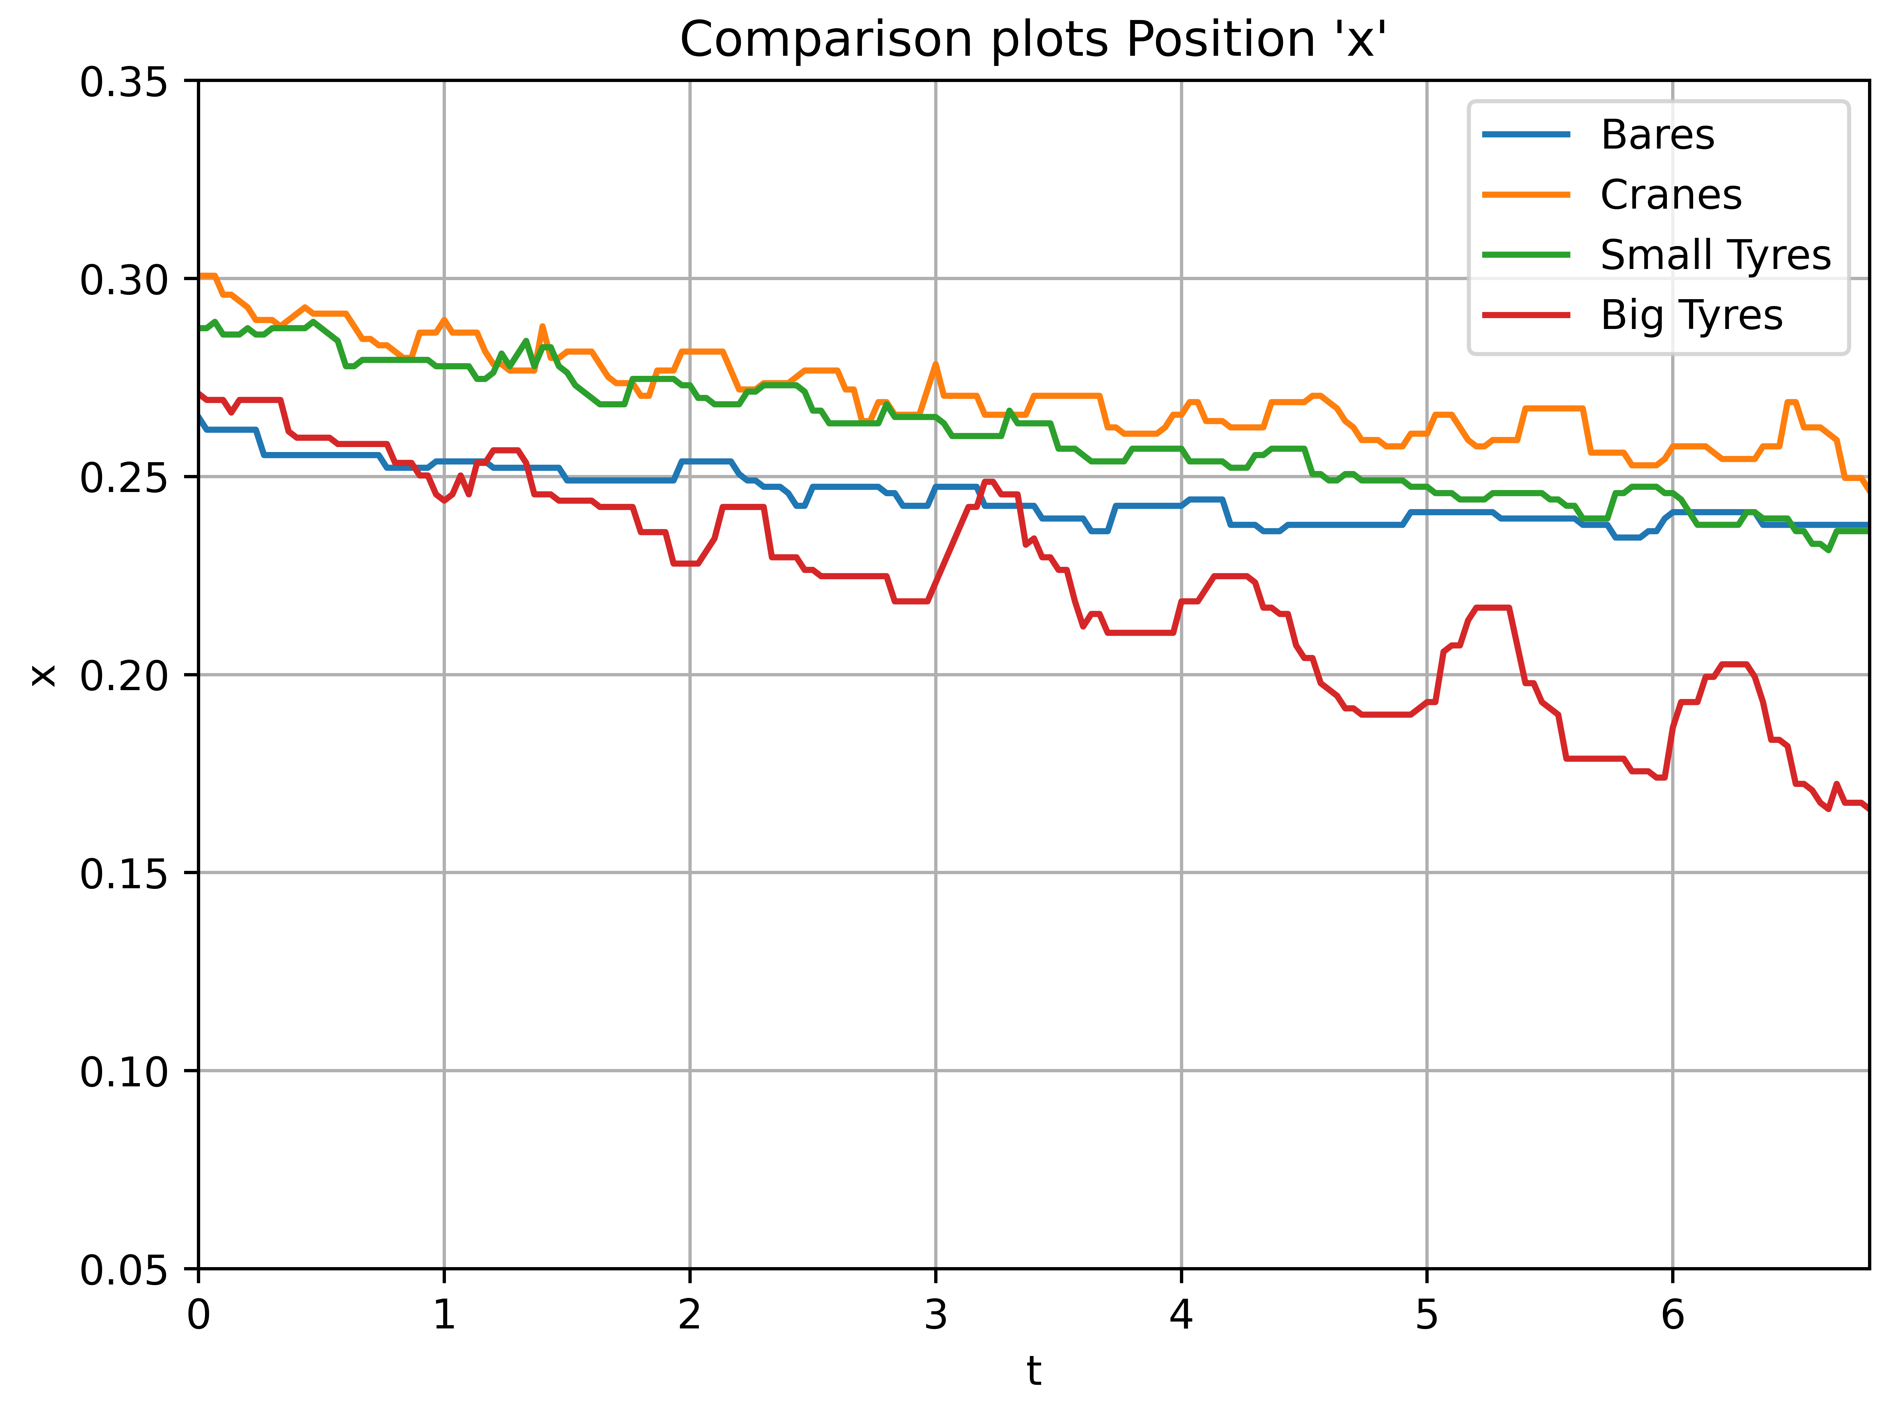
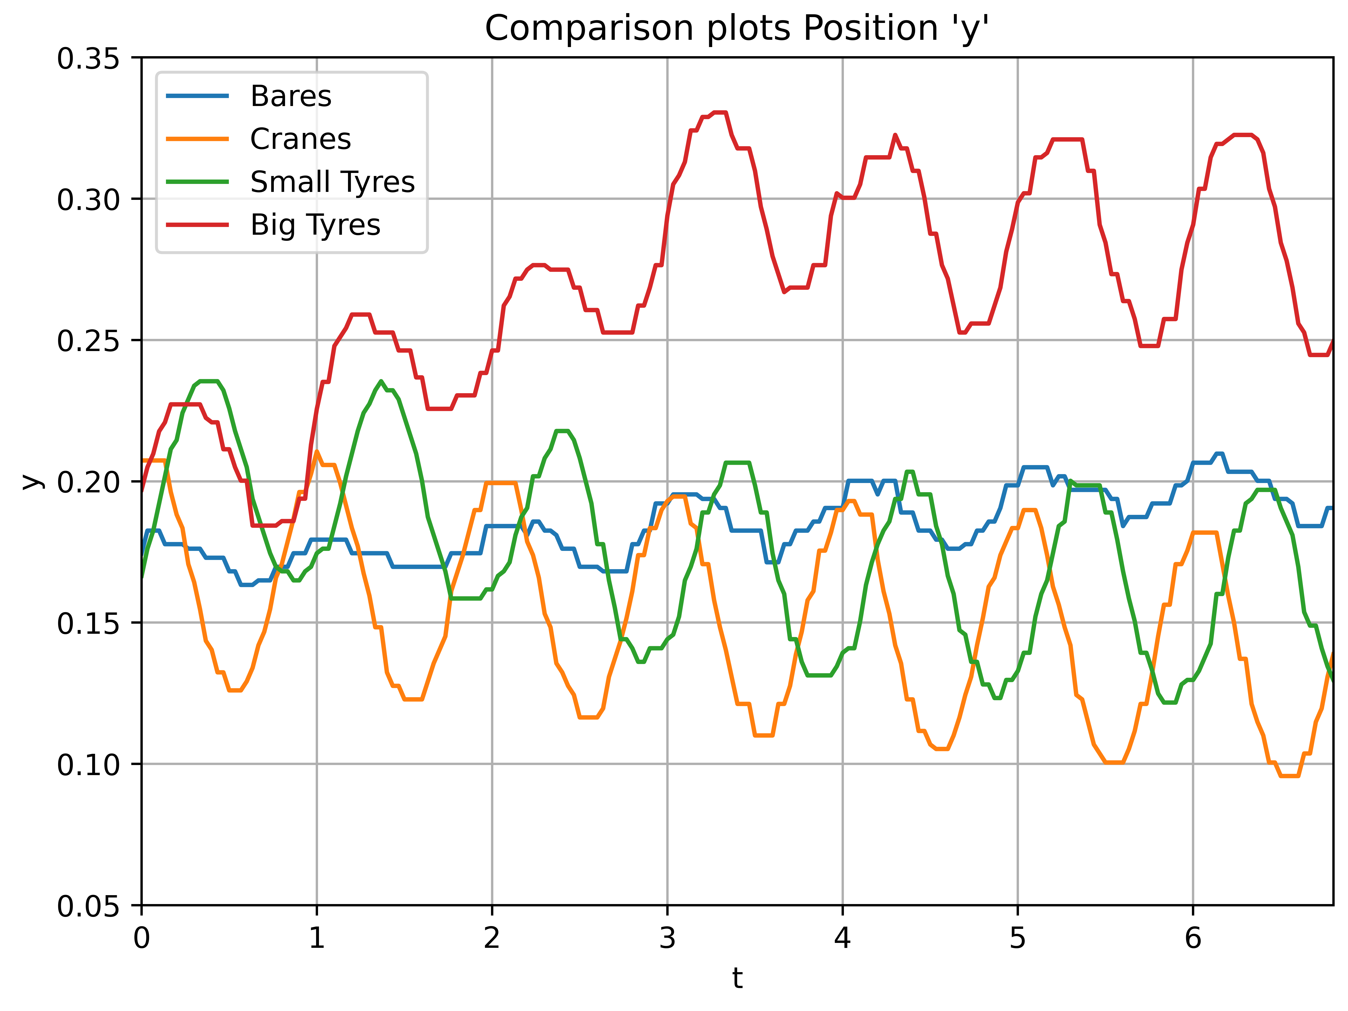
Results

Slide 14
Accomplishments

Slide 15

Accomplishments
Learned about Development of Physics-Informed Robots.
Successful Implementation and execution of Project idea
Future:
Incorporate more accurate frictional models.
Perhaps work on a more purpose oriented ``optimal” (Feedback control) to forgo the model uncertainties.

Slide 16
fin

